Slide 1

NYC Airport Delay Report
Yuerong Shu & Ziqi Yan

Slide 2
Background and Research Question
What operational factors best explain departure delay in NYC flights?

Slide 3

Initial Data Overview
This study uses the NYC Flights dataset (2023) from the nycflights23 package. The dataset contains detailed information on domestic flights departing from 3 New York City airports, including flight timing, delays, carrier information, aircraft characteristics, and weather conditions.
Our goal is to analyze factors that influence the probability of departure delay (greater than 15 minutes), according to U.S. Department of Transportation.
Used datasets: flights, weather, planes

Slide 4

Why Choosing This Dataset?
The data were collected throughout 2023 on a daily and flight-by-flight basis from publicly available aviation reporting systems and flight tracking sources. These records typically originate from airline operational reporting, airport systems, and federal transportation databases that monitor schedules, actual departure and arrival times, delays, cancellations, and route information.
Since the data come from real-world airline operations, they provide a valuable snapshot of transportation performance

Slide 5
Advantage of Using This Dataset:
The dataset includes:
continuous predictors: departure delay, distance, temperature etc
*capture numerical variation in flight timing and weather conditions
categorical predictors: airline carrier, origin airport etc
*represent structural and operational differences between flights.
The measurement time is relatively close to the present and little missing values

Slide 6

Overall Summary
Overall, the dataset is well-suited for logistic regression modeling. It contains a rich combination of operational, environmental, and structural (aircraft) variables that allow for a comprehensive analysis of factors influencing flight departure delays.

Slide 7
Data Processing and EDA

Slide 8
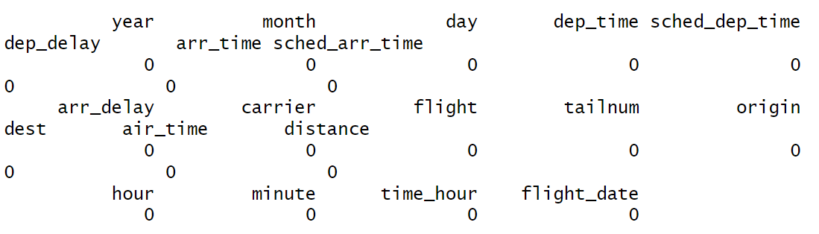
Missing Value in Dataset?
Flights

Slide 9
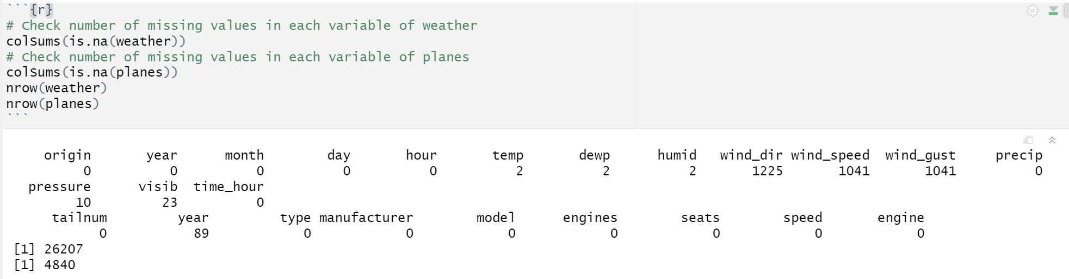
Missing Value in Dataset?
Weather & Planes

Slide 10
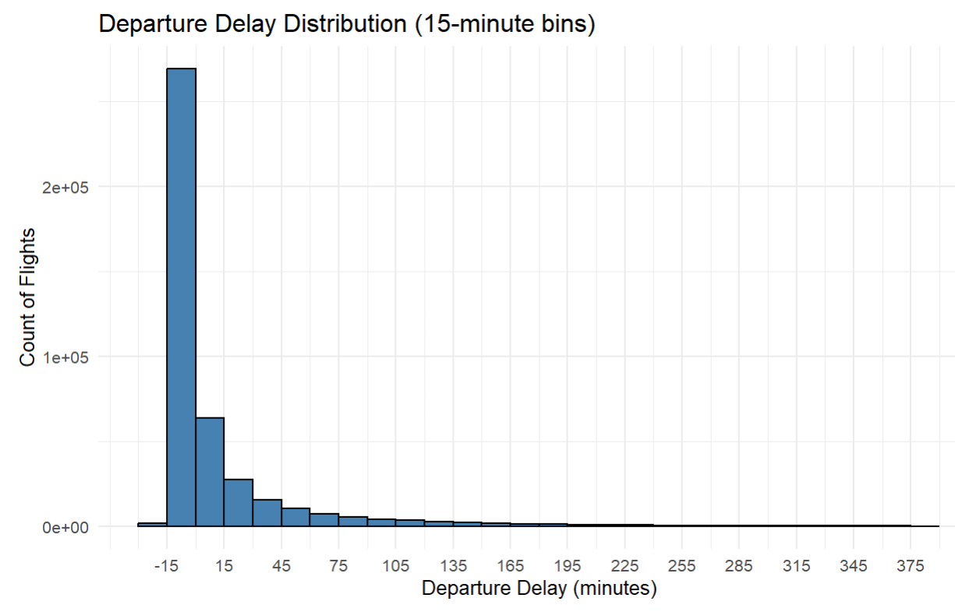
Response Variable Distribution

Slide 11
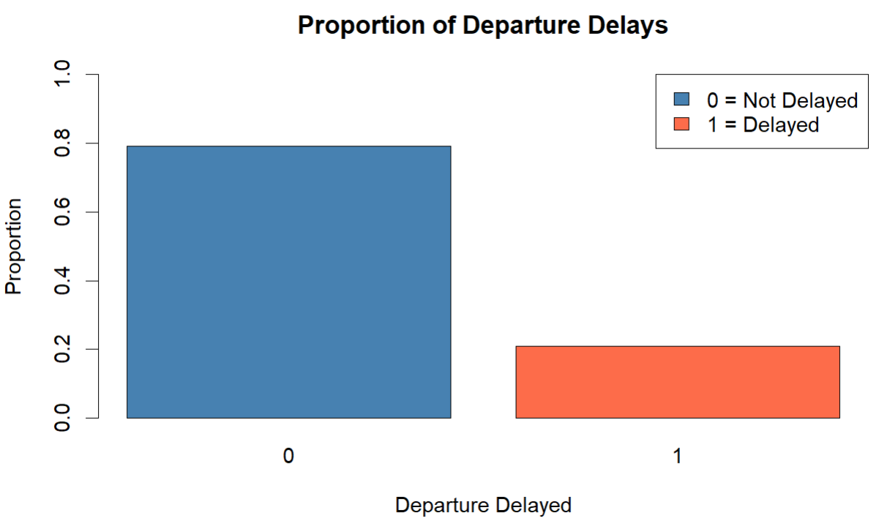
Response Variable Distribution

Slide 12
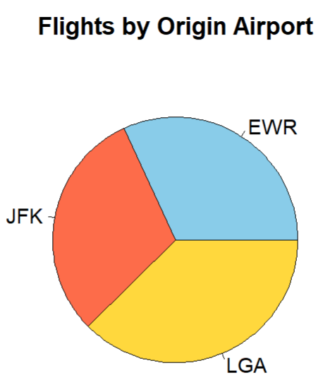
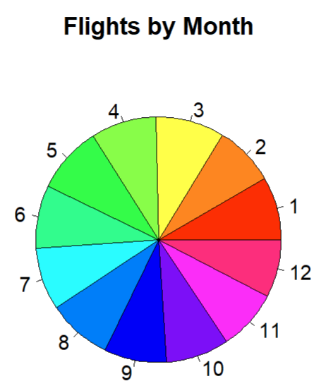
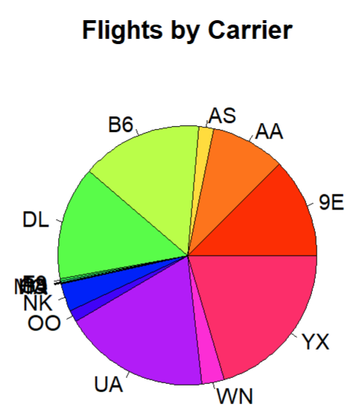
Categorical Predictors

Slide 13
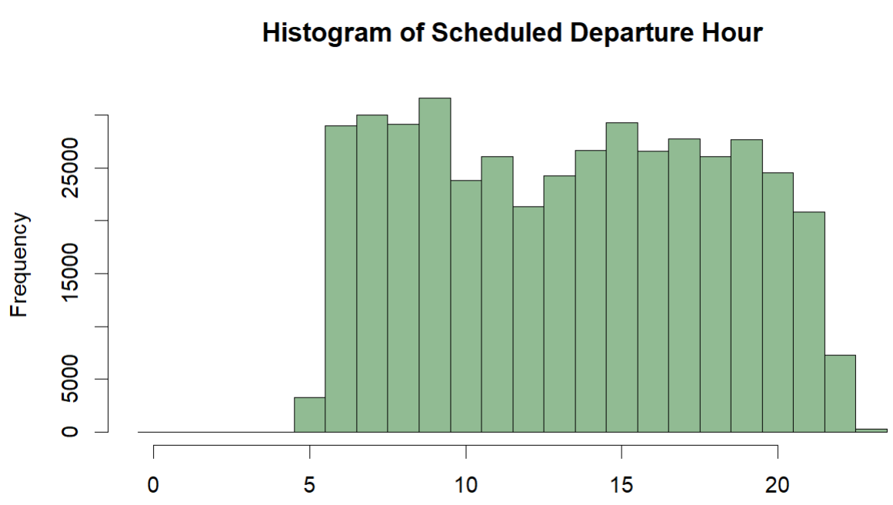
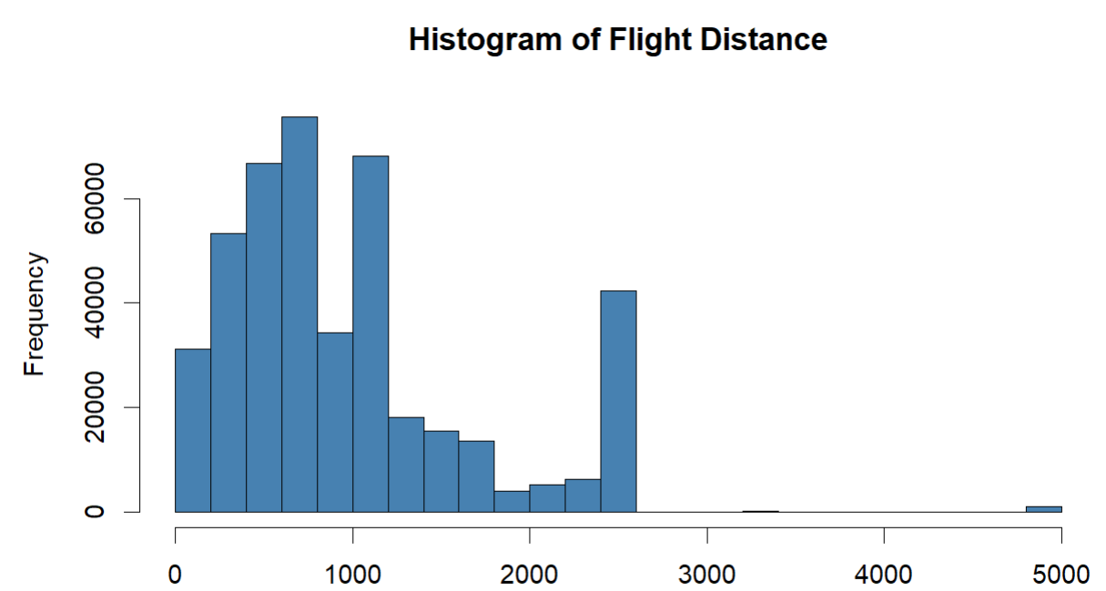
Quantitative Predictors

Slide 14
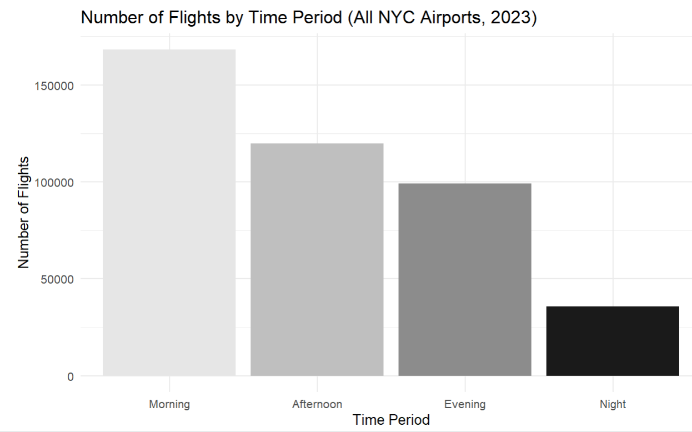
Interesting Findings: Time of the Day
The morning time period (5:00–11:59) is the busiest part of the day. Flight activity decreases as the day progresses, with the afternoon (12:00–16:59) still having a high number of flights, followed by the evening (17:00–20:59). The night period (21:00–4:59) has by far the smallest number of flights.
This graph suggests that most NYC flights are scheduled earlier in the day and flights of day shows a stable descending pattern.

Slide 15
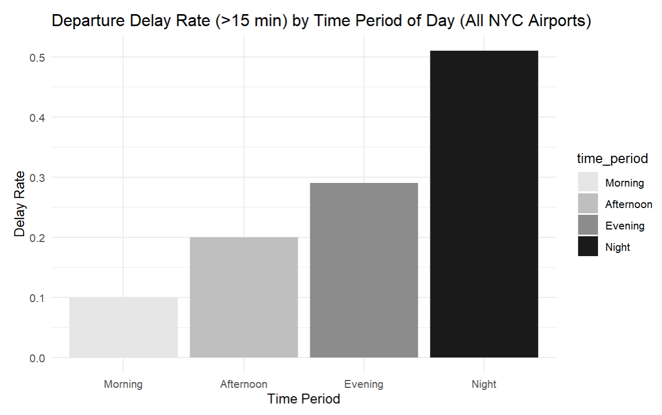
Interesting Findings: Time of the Day
Morning (5:00–11:59)
Afternoon (12:00–16:59)
Evening (17:00–20:59)
Night(21:00–4:59)
This graph suggests that most NYC flights delay possibility grows as time of day goes on.

Slide 16
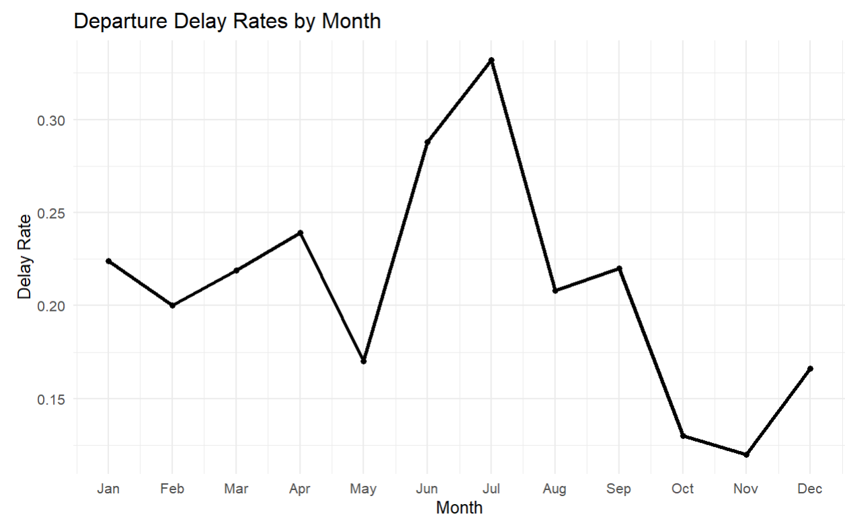
Interesting Finding: Month
This graph suggests that NYC flights delay is more likely to happen in summer.

Slide 17
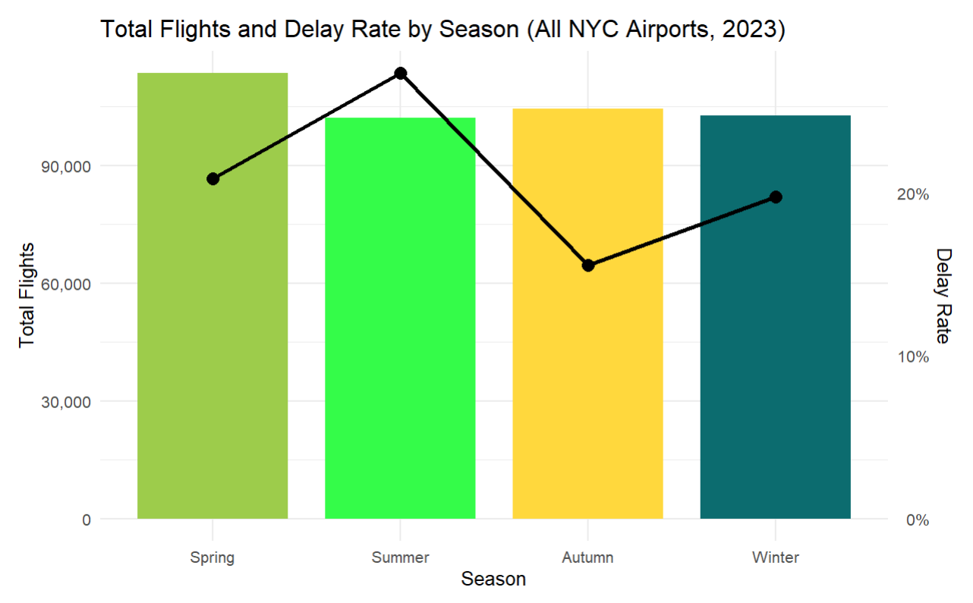
Interesting Finding: Season
This graph suggests that NYC flights delay is more likely to happen in summer.

Slide 18
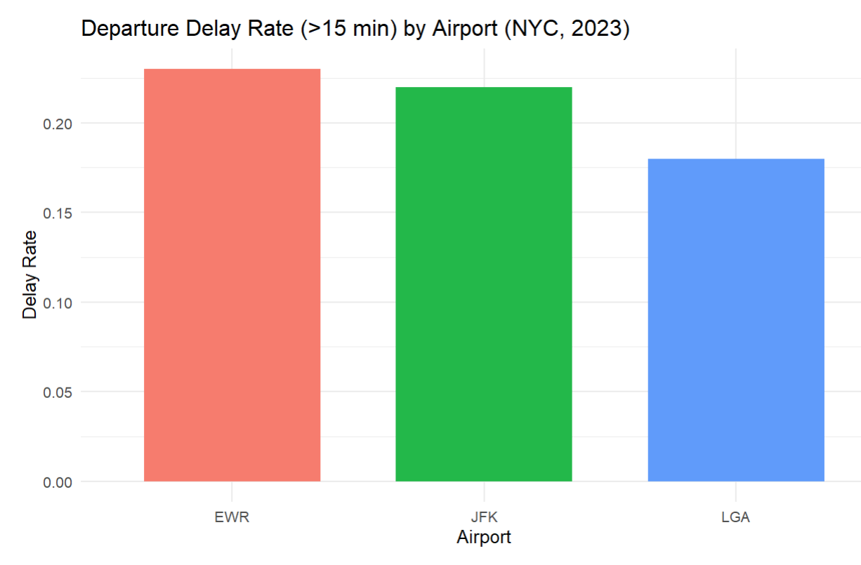
Interesting Finding: Airport

Slide 19
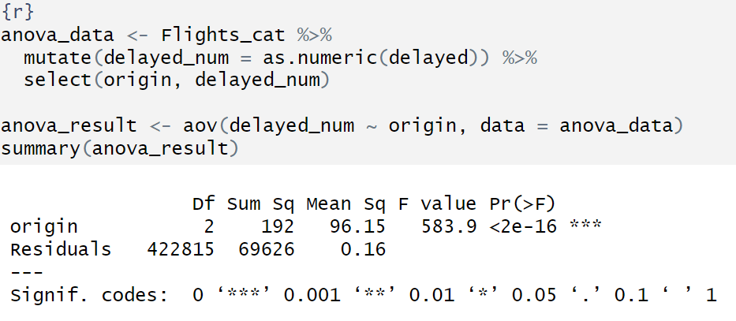
Significant predictor?
Null hypothesis (H₀): The average delay indicator is the same across airports, 𝜇JFK = 𝜇LGA = 𝜇EWR
Alternative hypothesis (Hₐ): At least one airport has a different average delay indicator, hereby airport
Alpha=0.05
Result: statistically significant

Slide 20
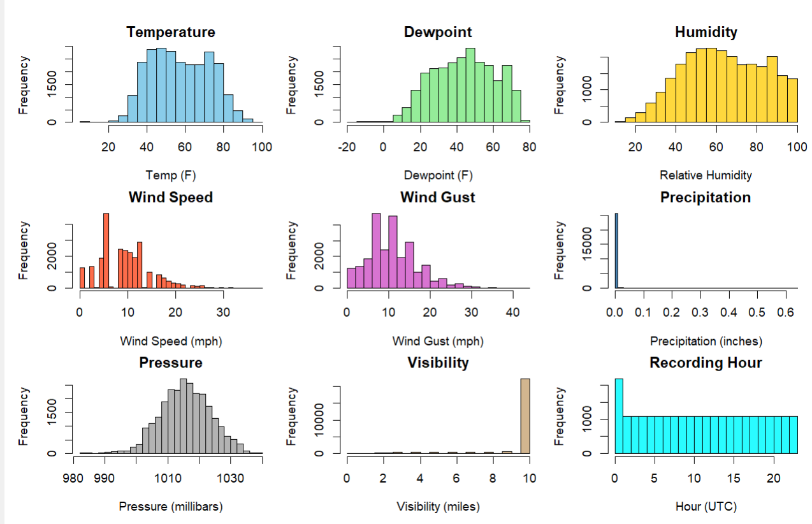

Slide 21
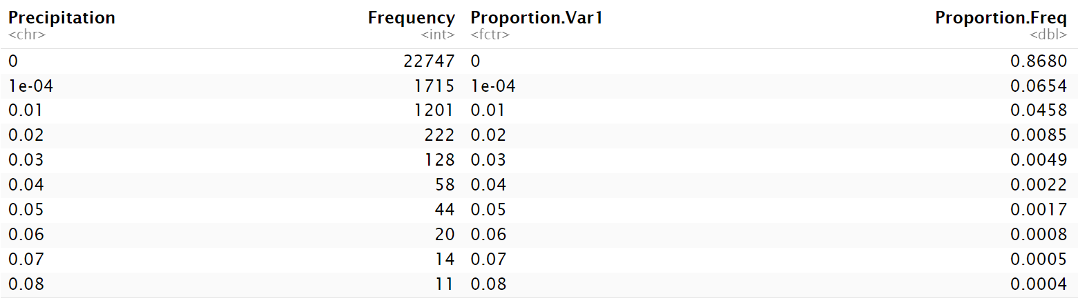
About variation of precipitation/visualbility
There is variation though the histogram does not show clearly.

Slide 22
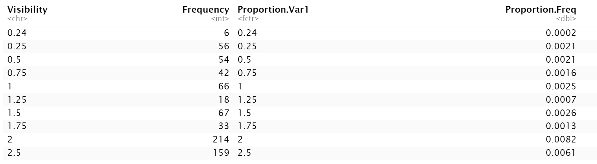
About variation of precipitation/visibility
There is variation though the histogram does not show clearly.

Slide 23
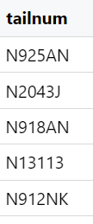
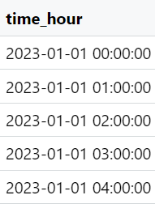
About Combined dataset
Contains 435352 observations, each row stands for one commercial flight departure
After dropping repeated variables, 37 variables are in the dataset and are used for further variable selection procedure, which will be explained later
Flights: single flight specific information
Weather: hourly weather conditions at the three NYC airports throughout 2023, combined to flights using
Planes: aircraft specific information

Slide 24
Modeling and Model Adjustment

Slide 25
Model development: Built logistic regression to predict departure delay.
Adjustment made: Added weather variables (temp, humidity, wind, visibility). Included aircraft model (grouped to avoid sparse levels). Removed missing values for consistency.
Goal: Improve accuracy based on the most "likely" important variables that may affect our predictions.

Slide 26
Variables we used
Carrier: Airline carrier code.
Origin:Departure Airport
Hour: Schedule departure hour
Month: Flight month
Temp: Temperature at departure time
Humid:Humidity level
Wind speed: Wind speed
Precip: Precipitation amount
Visibility:Visibility
Model: Aircraft plane model.

Slide 27
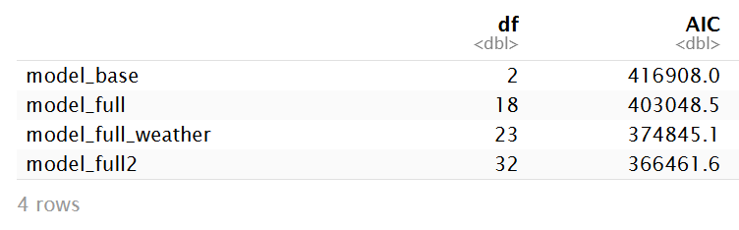
AIC Selection
AIC comparison: Used AIC to evaluate model performance. Lower AIC = better balance of fit and complexity

Slide 28
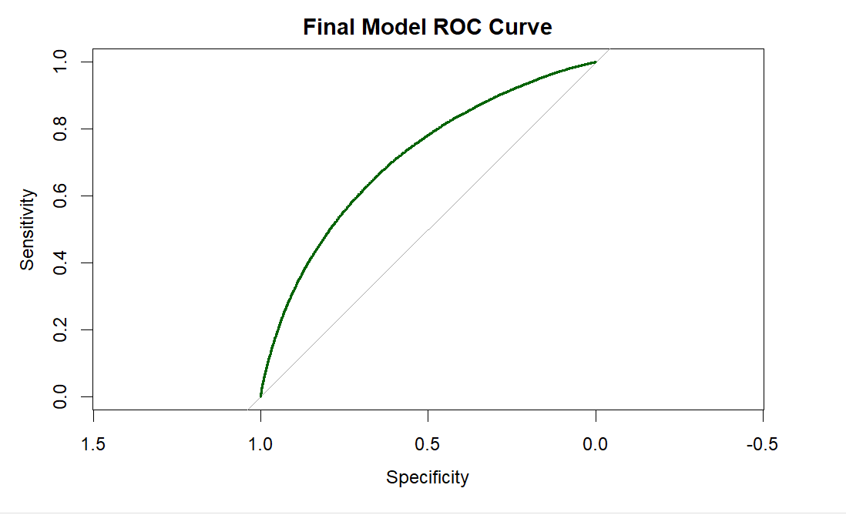
Final Model Insights
Aircraft type contributes additional predictive power.
Weather conditions (e.g., visibility, wind) have measurable effects
The final logistic regression model achieved an AUC of 0.7101, indicating acceptable predictive performance. This suggests that the model is capable of correctly distinguishing between delayed and non-delayed flights approximately 71% of the time. Compared to a baseline model, this reflects a meaningful improvement in predictive accuracy.
Flight delays are influenced by a combination of factors

Slide 29
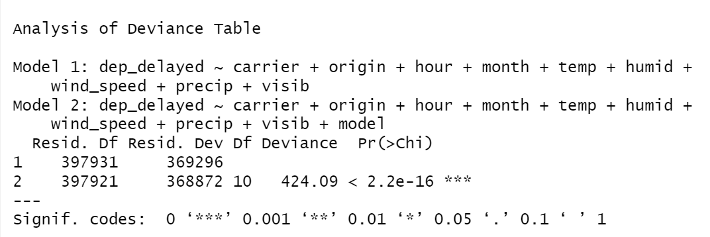
Likelihood Ratio Test to check if model variable should be added

Slide 30
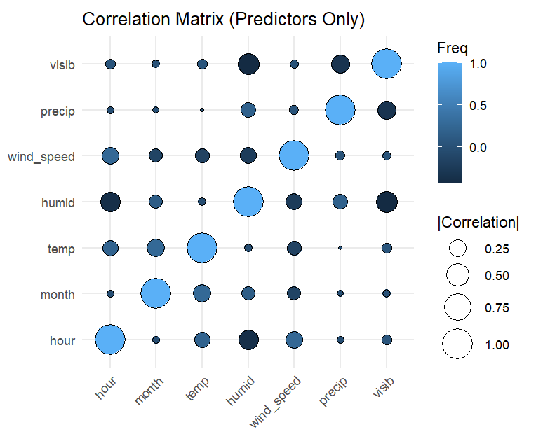
Initial Correlations
From the predictor-only correlation matrix, we can see that several environmental and temporal variables are strongly intercorrelated, with correlations approaching 0.75–1.00, particularly between temperature and month, as well as between humidity and precipitation. Variables such as hour and month show near-zero correlations, suggesting they provide relatively unique information.

Slide 31
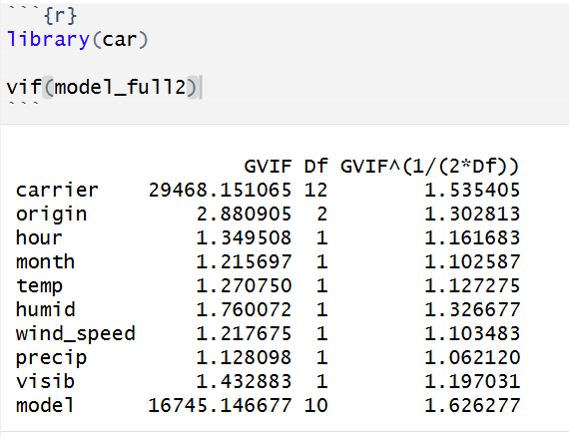
VIF check
The Variance Inflation Factor analysis indicates that all predictors in the final model have adjusted values close to 1, suggesting that multicollinearity is not a concern. This confirms that the included operational, weather, and aircraft variables provide largely independent information for predicting departure delays.

Slide 32
Leverage Check
Leverage values are very low (roughly 0.000 to 0.014).
The red dashed Cook’s distance curves (likely for levels like 0.5, 1.0) are not crossed by any point.
Most points lie within -2 to +2, which is acceptable.

Slide 33

Analysis, Interpretation and Conclusion

Slide 34
Final Model and Why This Makes Sense?
Our final model includes: Time factors (hour, month)+Airline & airport (carrier, origin)+Weather variables (temp, wind, visibility, etc.)+Aircraft model
Flight delays are influenced by many factors, not just one. Time of day captures congestion effects. Airline and airport reflect operational differences
A simpler model with fewer variables would fail to capture this complexity and would be less reliable and less persuasive.

Slide 35
Throughout All the work, Our Answer is...
Flight delays cannot be explained by one factor alone—they result from the combined effects of time, airline/airport operations, weather conditions, and aircraft characteristics.

Slide 36
Conclusion
Flight delays are influenced by multiple interacting factors, not a single cause.
Key predictors include:
Time factors (hour, month)
Airline and airport characteristics
Weather conditions
Aircraft model
Time of day captures congestion patterns, while airline and airport variables reflect operational differences.
Weather and aircraft-related factors further improve model accuracy and realism.
A model with fewer variables would oversimplify the problem and reduce predictive performance.

Slide 37
Concerns and Problems
We wanted to create Domestic_Flight as an indicator; however, we gave up this idea due to technical restriction.
There are moderate missing values in weather dataset and they are usually concentrated, simply omiting lines corresponding to these days will cause data missing in specific days
The flights dataset only includes flights after 5:00AM, however it should not be the case.

Slide 38
Our next steps?
Keep on improving our GLM model
Introduce machine learning to handle interactions automatically and compare results' accuracy with present model.

Slide 39

Questions?

